Slide 1
Walt Disney Elementary School
Board of Education Update | Dec. 6, 2022
Dr. Dan Zdanowski, Principal
Costa Tavelaris, Assistant Principal
Katie Picha, School Counselor and SEIT Representative
Peter Sacheli, Building Math Teacher and ILT Representative

Slide 2
Topics of Discussion
District Goals
Building Pillars
Family and Community Engagement
DEI and Restorative Practices
Access to Rigorous Instruction

Slide 3
District Goals 2022-23
Cultivate a welcoming, affirming, and equitable environment where barriers are removed, empowering growth, learning and success for all​
Maximize student growth by being responsive to the academic and social-emotional needs of the learning community​

Slide 4
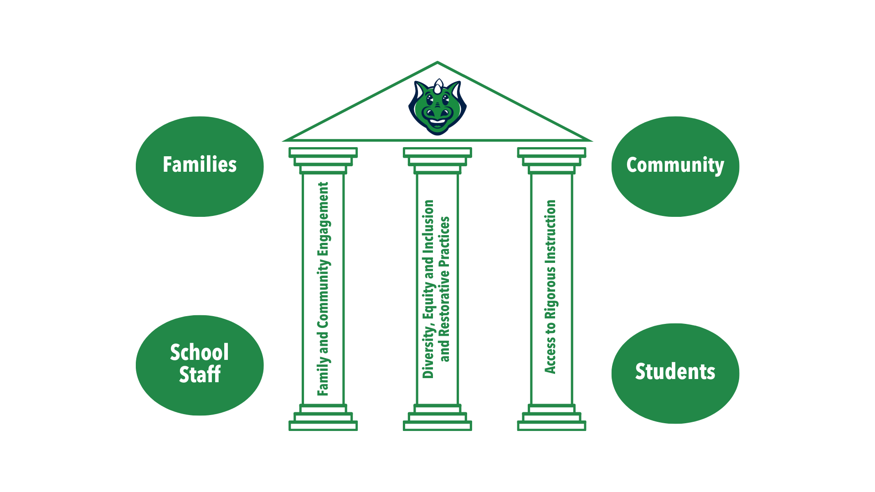
Building Goals 2022-23

Slide 5
Family and Community Engagement
Significant Accomplishments:
Increased PTO participation
Increased access to SIT meetings by sharing recording of virtual meetings
Increased number of school-based volunteers
Increased social media engagement
Launched new, year-round, online school store
More than 1,000 views of our new monthly e-newsletter, The Disney Digest
More than 500 attendees at Walt Disney Elementary’s Fall Fest
Next Steps:
School website redesign
Winter and spring school and community events
Collaborating with WDPTO to develop a long-range strategic plan

Slide 6
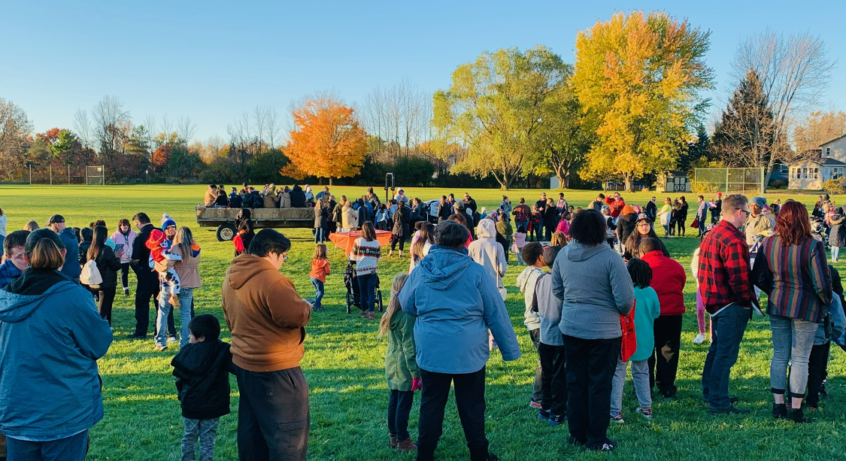
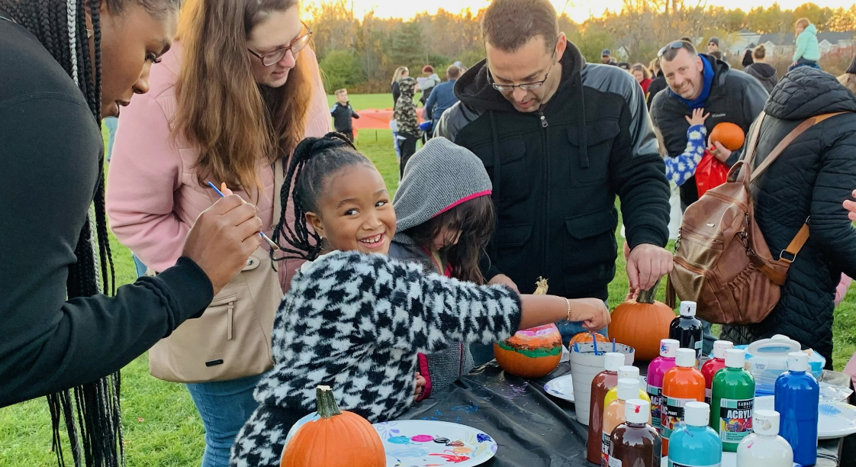
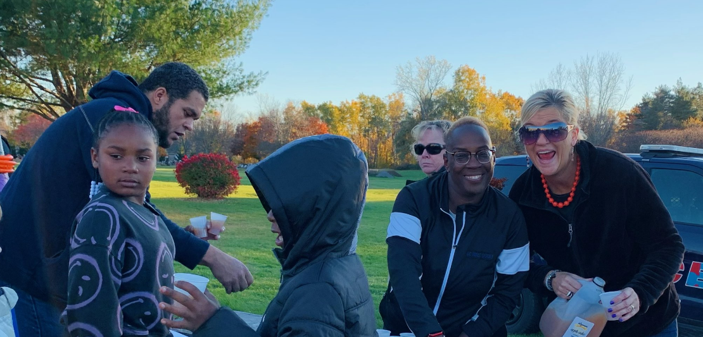
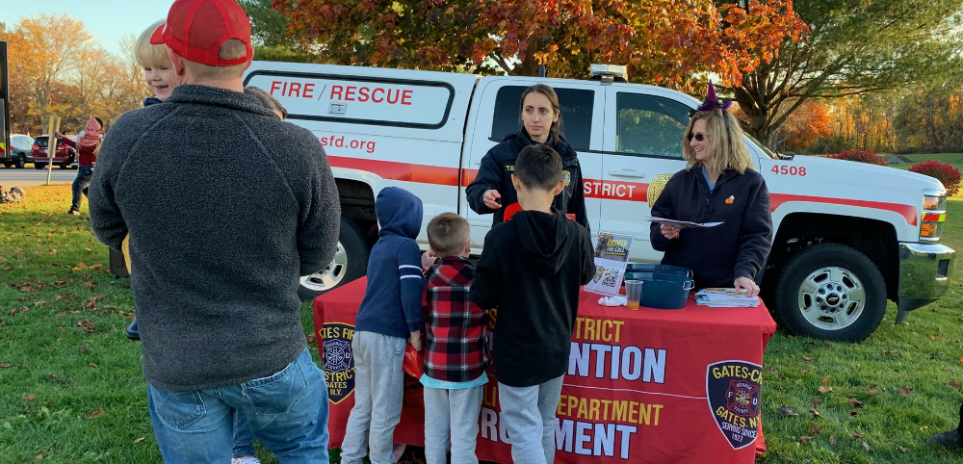

Slide 7
DEI and Restorative Practices
Significant Accomplishments:
Staff survey
Monthly common professional learning experiences with staff pertaining to circles
Monthly building-wide, standards-aligned, circle questions
Building pairs established for common circle questions
Created a video of students sharing their perspectives on building-wide circles with staff
Next Steps:
Vertically align book titles to support common circle questions
Monthly common professional learning experiences with staff pertaining to the NYS CR-SE framework
Emphasize areas of overlap between the building’s circle questions and the NYS CR-SE framework

Slide 8
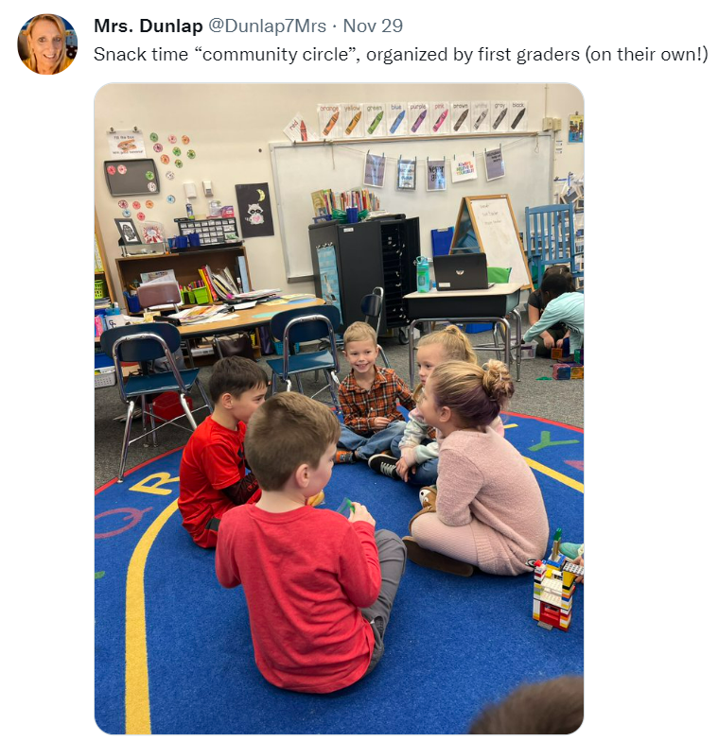
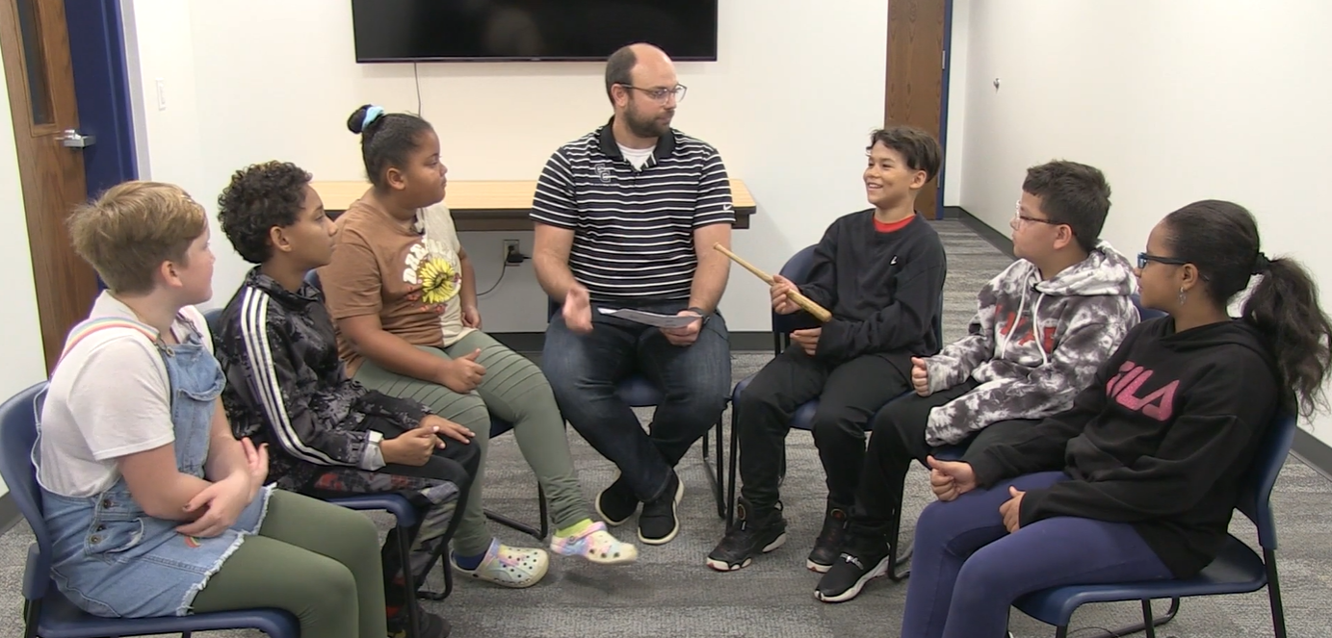
Disney fourth- and fifth-graders filming a video to share their circle perspectives with staff
Disney first-grade students organizing their own community circle at snack time

Slide 9
Access to Rigorous Instruction
Significant Accomplishments:
Monthly common professional learning experiences with staff pertaining to the Everyday Math program
Common data-driven dialogue protocol
Quarterly progress monitoring systems with grade-level teams
Structures to support the implementation of the Next Generation Learning Standards
Next Steps:
Refinement of MTSS data collection processes
Student and family i-Ready engagement
Art/Library/Classroom integrated writing project

Slide 10
Walt Disney Elementary School
Board of Education Update | Dec. 6, 2022
Dr. Dan Zdanowski, Principal
Costa Tavelaris, Assistant Principal
Katie Picha, School Counselor and SEIT Representative
Peter Sacheli, Building Math Teacher and ILT Representative

